Slide 1
Heart of Knowledge
Week 2 Progress Update
Code-Blooded
Sammy Jones, Michael Schriefer, Zachary Mcnay, Peyton Hayes

Slide 2
Overview for Week 2
Wrote 159 Lines of Code
315 Lines in Total
Overall Burndown Rate: 18.5%
3 Requirements Fulfilled (Burndown 11%)
8/28 Fulfilled
Total Burndown: 28%
6 Tests Completed (Burndown 9%)
6/69 Completed
Total Burndown: 9%

Slide 3
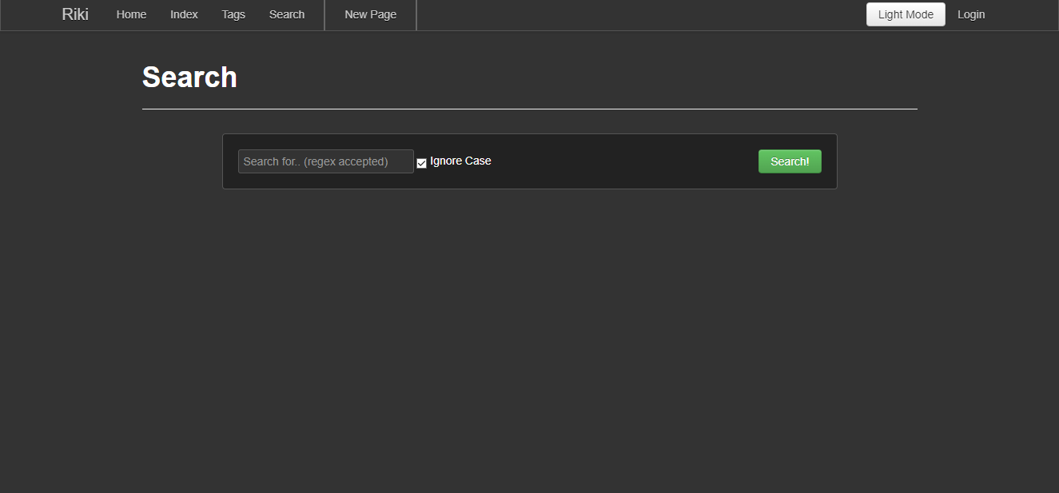
Feature 1 - Dark Mode
This week I focused on creating unit tests.
125 lines of code was written
3 unit tests written
3 requirements
10 tests including Unit,
Integration, Regressions,
and Acceptance
10% burndown this week
70% burndown total

Slide 4
Feature 2 - Custom Templates For Pages
This week I working on a way to let users set the background and text color of a page
15 lines of code
3 requirements
10 tests including Unit, Integration, Regressions, and Acceptance
20% burndown this week
20% total burndown total

Slide 5
Feature 3 - User Default Template
This week I spent most of working on feature 2.
0 lines of code
3 requirements
10 tests including Unit, Integration, Regressions, and Acceptance
0% burndown rate

Slide 6
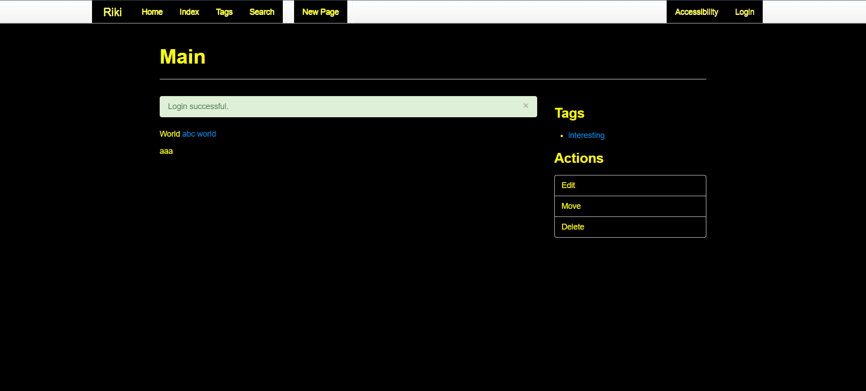
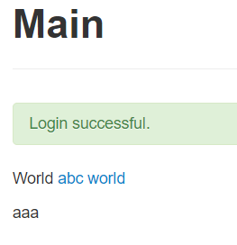
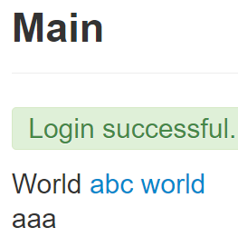
Feature 4 - Visibility/Accessibility Modifier - Peyton
This week I was able to implement the functionality of the high-contrast mode as well as the large text.
37 more lines of code written
8 Requirements (5 Met so Far)
12 Tests including Unit, Integration, Regressions, and Acceptance
25% Burndown for week
63% Burndown Total

Slide 7
Feature 5 - Citation Generator - Peyton
This week was spent finishing the implementation of Feature 4 which is almost completely done. Once again, the work done implementing Feature 4 will assist when working on Feature 5, so we expect it to go a little quicker than Feature 4.
0 lines of code written
7 Requirements
13 Tests including Unit, Integration, Regressions, and Acceptance
0% Burndown Total

Slide 8
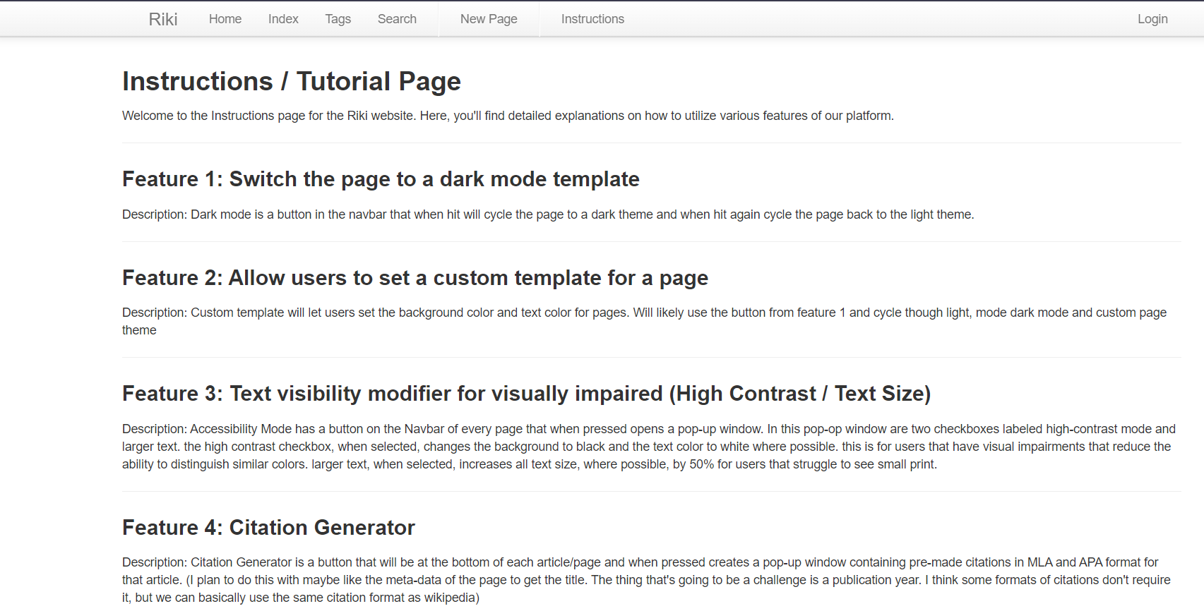
Feature 6 - Instructions / Tutorial Page
This week I have been able to get a strong start with this feature. I was able to create a new HTML page with the correct CSS links for styling. I plan to update it as other features get completed.
107 Lines of code written
2 Requirements
4 Tests including Integration, Acceptance, and Regression Testing
75% Burndown

Slide 9
Feature 7 - Table of Contents / User Privilege
This week I have been mostly focusing my information page feature. Same plan currently for this feature but might consider just focusing on user privilege with certain pager access.
0 Lines of code written
2 Requirements
10 Tests including Unit, Integration, Acceptance, and Regression Testing
0% Burndown

Slide 10


